Slide 1
ART that communicates
Traditional and Contemporary Expressions

Slide 2
Theme 1: Art and Everyday Life
Pottery
Baskets
Household items
Headrests (used for resting or sleeping)
Homes / architecture
Our case study in class:
Ndebele house painting in South Africa

Slide 3
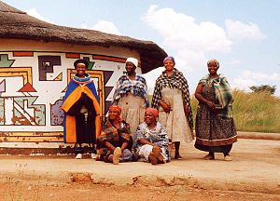
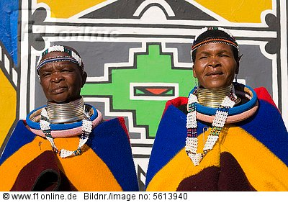
Ndebele house painting in South Africa
These symbols were a type of communication between sub groups of the Ndebele people.
They stand for their culture and their resistance to their past & current circumstances.

Slide 4
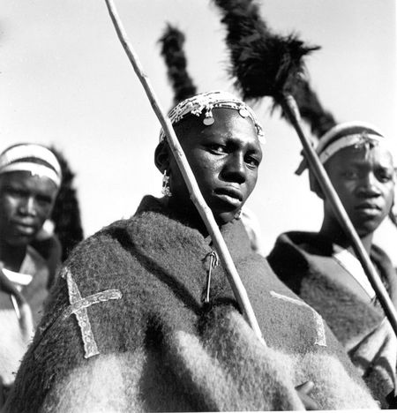
Ndebele house painting in South Africa
Ndebele (Un duh BEE lay) - Bantu-speaking people inhabiting parts of South Africa, and Southwest Zimbabwe.
Up until the late 1900s the Ndebele people were very fierce warriors and land owners of vast territories.
The Ndebele now number close to 2 million

Slide 5
Ndebele house painting
the Ndebele people went to war with the neighboring White Boers (Afrikanners), but lost those battles which brought on punishing treatment by the Boers and great suffering.
Through those hard times, symbols were created by the Ndebele people to express their sadness. These symbols were the beginning of the African art known as Ndebele house painting.

Slide 6
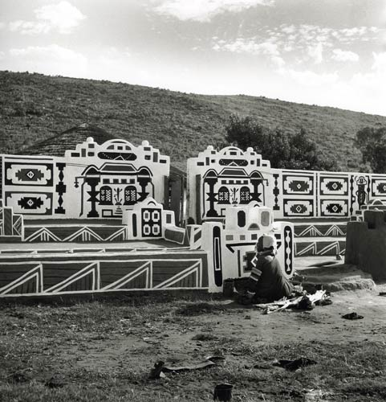
Women artisans
wall paintings are traditionally done by the Ndebele women
It was their secret code to their people, disguised to anyone but the Ndebele.
Notes:
-Wikipedia

Slide 7
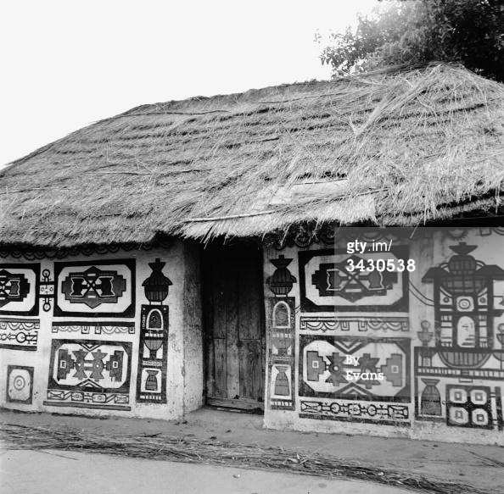
How it continued…
The Boer farmers did not understand the meaning and only viewed it as cultural art that was not harmful, so it was allowed to continue.
Notes:
-Wikipedia

Slide 8
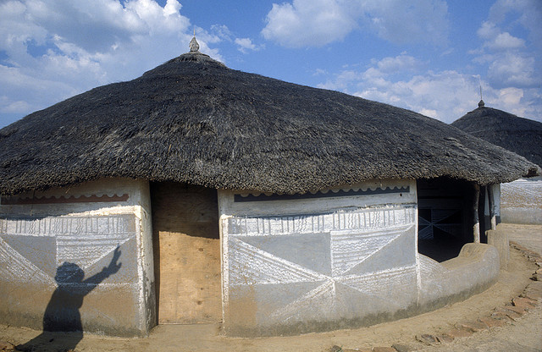
The process
The patterns were tonal and painted with the women's fingers.
The original paint laid down on the house was a limestone whitewash.
The colors added to make the paintings were mostly natural pigments consisting of browns, blacks, and shades of yellowish brown.

Slide 9
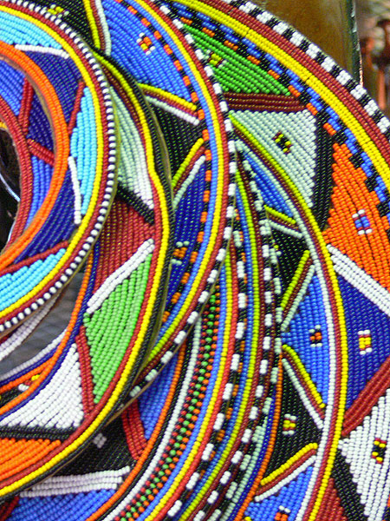
symbols and patterns based off of Ndebeles’ beadwork.
Most of the patterns were of a V shape and a very simple triangle on a large shape of color.
The patterns, earth tones, directions, and sizes were more important than the present day vivid and bright colors.
Notes:
Image beadwork: necklaces
http://m0.i.pbase.com/o3/62/630162/1/125189520.WbyW64Ha.P1030309.jpg

Slide 10
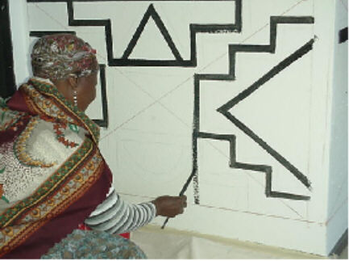
Symbolic language
The vibrant symbols and expressions portray communications of
personal prayers,
self-identification,
values, emotions,
and marriage.

Slide 11
Ndebele house painting in South Africa
These symbols were a type of communication between various residents and their neighbors
They stand for their culture and their resistance to their past & current circumstances.

Slide 12
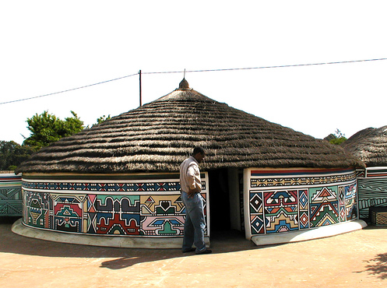
Modern styles & transformations
Continuity and change
One thing that has changed since the beginning of the house painting wall art and the present day wall art is their styles.

Slide 13
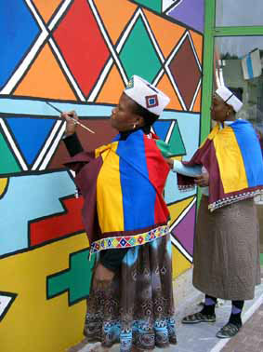
Reflects back on the reputation of the women and their offspring
The women of the Ndebele are often the tradition carriers and the main developer of the wall art of their home.
The tradition and style of house painting is passed down in the families from generation to generation by the mothers.
Notes:
Image: Ndebele3 2 women
http://www.bulbinblue.com/Public/BMFR/0-Inspirations/Ndebele3.jpg

Slide 14
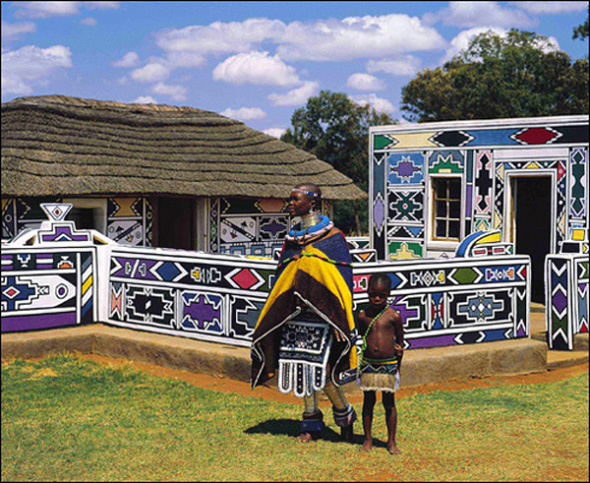
A well painted home shows the female of the household is a good wife and mother

Slide 15
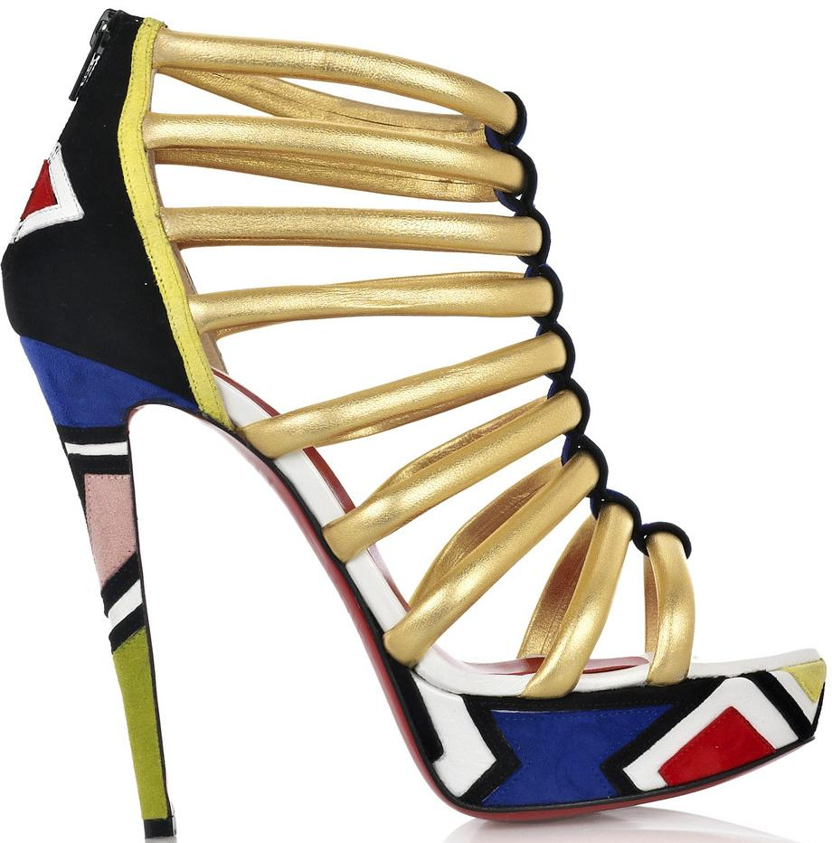
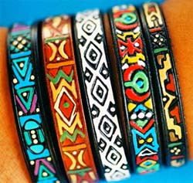
Ndebele art’s influence – contemporary times
Womens’ shoes
Ndebele bracelets
Notes:
Ndebele bracelets
http://citysearchblog.yellowpages.co.za/citysearchblog/wp-content/uploads/2009/08/ndebelebracelets.jpg
Womens’ shoes
http://1.bp.blogspot.com/_vH19L7exuMo/TFd7g0scYyI/AAAAAAAAAYM/bMXB6OAuslc/s1600/Ulona.jpg

Slide 16
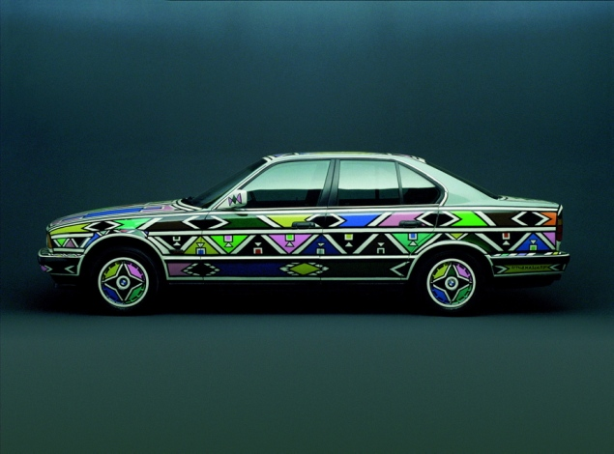
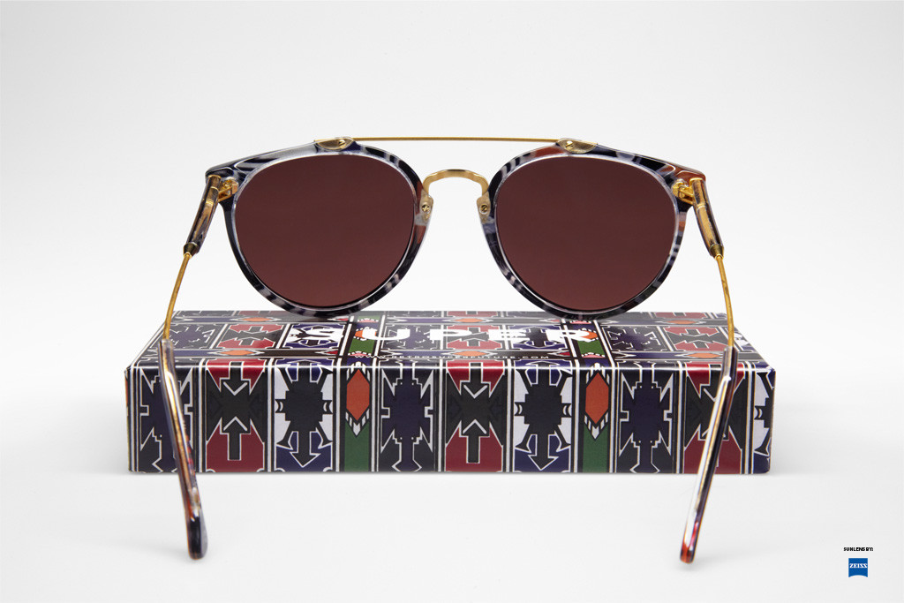
991 - BMW 525i designed by Esther Mahlangu -South African painter
Art car: Mahlangu covered the vehicle in the bright geometrics of African Ndebele house paintings. -
shades
South African painter Esther Mahlangu https://www.youtube.com/watch?v=ozXYBArCfrw
Esther Mahlangu: “Ndebele art showed me the world” 1:35 mins
Notes:
South African painter Esther Mahlangu was the first African artist to design an Art Car. Mahlangu covered the vehicle in the bright geometrics of African Ndebele house paintings. The patterns, outlined in black, are always on a white background to make the fill colors even more vibrant. The design is truly evocative of Mahlangu's heritage.
Read more: http://www.nydailynews.com/autos/art-drive-bmw-shows-art-cars-gallery-1.1159803?pmSlide=9#ixzz2DZ9V0SCF
Ndebele art on car image:
http://assets.nydailynews.com/polopoly_fs/1.1159799.1347656339!/img/httpImage/image.jpg_gen/derivatives/gallery_635/1991-bmw-525i-designed-esther-mahlangu.jpg
sunglasses / shades
http://urbnmag.com/wp-content/uploads/2012/04/112_retro.jpg

Slide 17
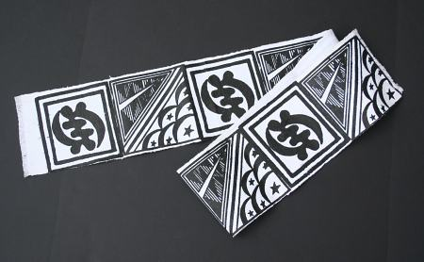
Theme 2: Art and Religion
Examples: ritual items such as… masks, drums, staffs divination tools such as… divination trays, clothing…
Our case study: adinkra textiles from Ghana

Slide 18
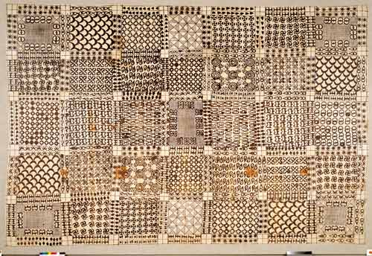
adinkra textiles in Ghana
The Asante of Ghana and the Gyaman of Cote’ d’Ivoire (Ivory Coast) have, according to legend, given us the Adinkra symbols: the first symbols to be used on textiles.

Slide 19
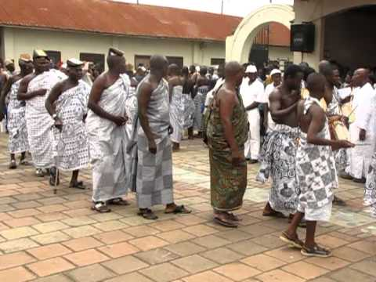
Traditional use
Originally, these highly valued and expensive cloths were reserved for spiritual leaders and royalty and were worn only during important ceremonies, events, and rituals.

Slide 20
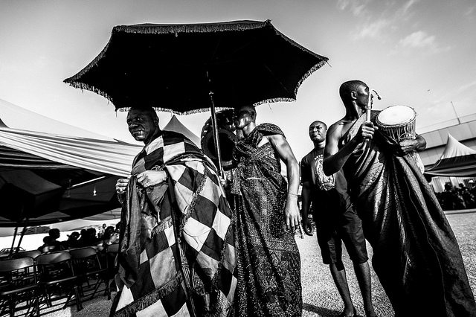
Religious meaning
Adrinkra textiles held great spiritual significance in initiation rites, funeral rites and mourning periods.

Slide 21
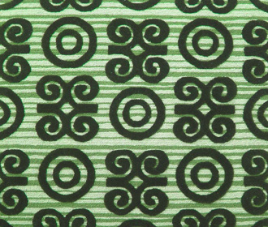
A combination of symbols in some kind of pattern
“Adinkra” means roughly “farewell” or “goodbye”.

Slide 22
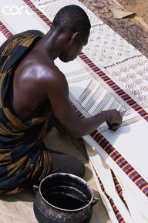
Traditionally adinkra cloths were made by Male artisans
Many Ashanti villages specialize in adrinka production, with men performing most of the tasks. Techniques are usually passed down from father or uncle to sons and nephews.
Each piece is usually a group effort rather than the work of a single artist.

Slide 23
The process of making the cloths
Dark Adinkra aduro pigment is made by soaking, pulverizing, and then boiling the inner bark and roots of the Badie tree (Adansonia digitata) in water over a wood fire. Once the dark color has been released, the mixture is strained, and then boiled for several more hours until it thickens.

Slide 24
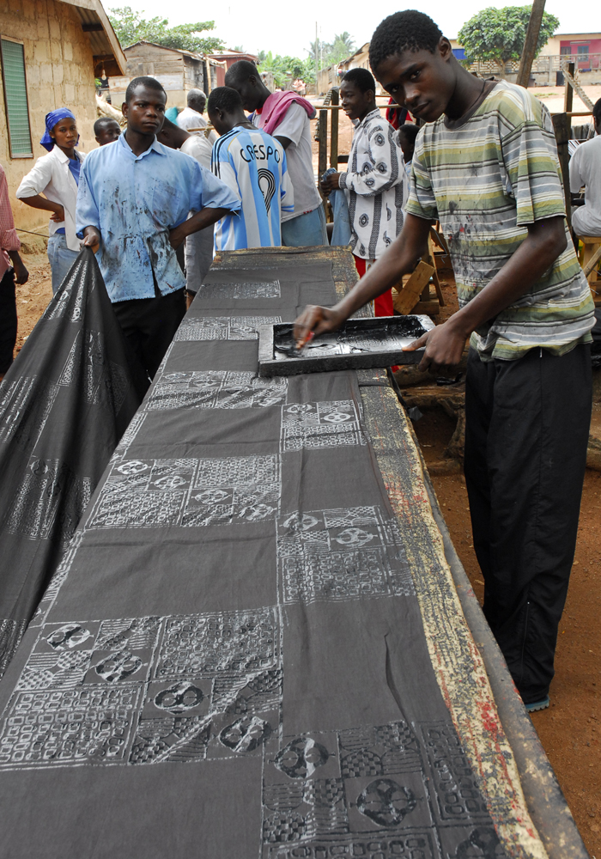
Involves an old printmaking system
In preparation for stamping, cotton material that has been sewn together into a large square or rectangle is folded lengthwise, with one edge exposed.
A thin layer of foam rubber is laid over a few boards, then the top and bottom of the strip are nailed in place,
then parallel and perpendicular lines (printed with a comb dipped into adinkra duro) divide the cloth into sections.

Slide 25
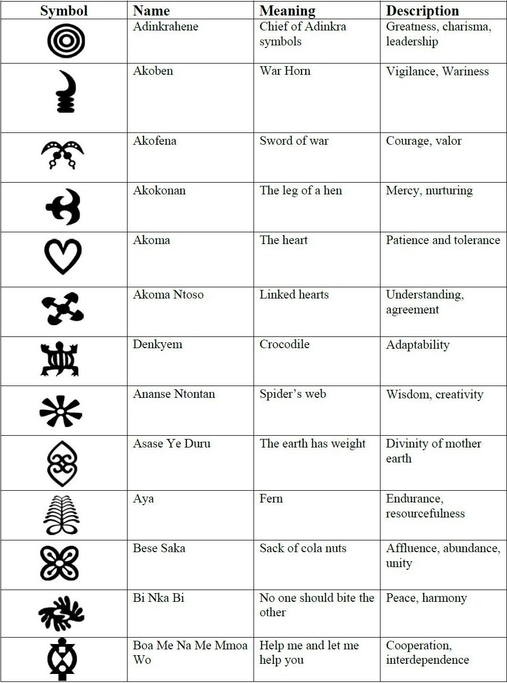
A symbolic language
After choosing several appropriate symbols from a chart, the corresponding stamps are selected.
http://www.flickr.com/photos/avmobley/2927423965/

Slide 26
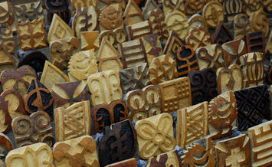
Pre-made stamps
the stamp is dipped into the colorant; then is placed on down and rocked across the surface to the other edge.
The same stamp is then re-dipped into the colorant and printed, over an over until the section has been filled.

Slide 27
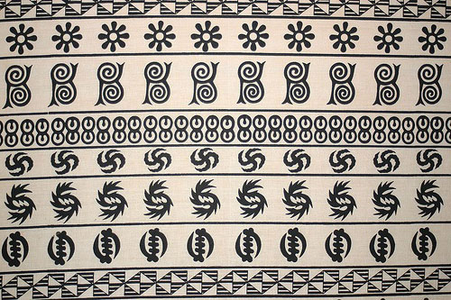
Traditional and modern techniques
Although hand-woven cotton was utilized in the past, today pieces of machine-woven fabric are also used.
They are joined together by hand or with a sewing machine and then hand-printed to produce large adinkra cloths.

Slide 28
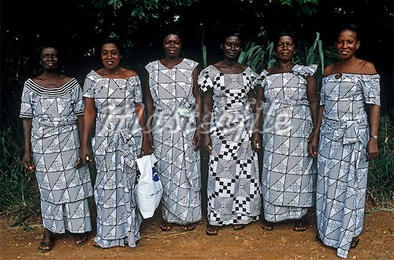
Printed textiles are made into various styles of clothing.
These adinkra textiles are stylishly wrapped around the bodies of women and men attending funerals and other special events.

Slide 29
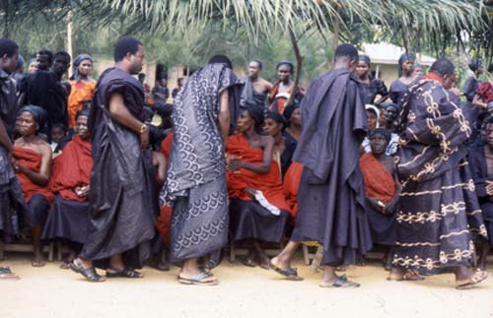
Communication in motion
The display of important Adinkra symbols shows respect for and communication with the deceased and are often used as a means of saying goodbye to loved ones that have passed.

Slide 30
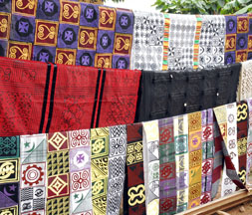
Contemporary use
Today, Adinkra symbols are worn by everyone, and are commonly seen at weddings, festivals, and naming rites.
This is an adinkra textile sale…
Notes:
http://www.tumblr.com/tagged/adinkra?before=1313241726

Slide 31
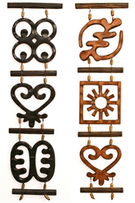
Adrinka wall panels
You can find them decorating homes and also in use for many business purposes.

Slide 32
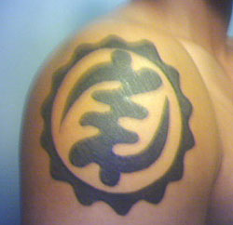
Adinkra can be seen everywhere in Ghana
Adinkra also shows up in jewlery
Poster art,
On household objects
And even tattoos!
Notes:
Arts of Ghana https://www.createspace.com/204781
For streaming video go to http://www.uiowa.edu/~africart

Slide 33
Theme 3: Art & Body Adornment
(Status, communication, or merely fashion)
Many items such as…
Beads or metal Jewelry
Headbands / hats / head-wraps
Body paintings
Scarification markings on face and body
Clothing (Traditional & modern dress)
Our class Case studies:
Zulu beadwork from South Africa and
Hairstyles from Nigeria

Slide 34
Zulu Beadwork of South Africa
Using glass beads, bright colors and repeating geometric designs Zulus make art made to be worn on the body
Examples: necklaces, headwear, arm or leg bands, etc.
In traditional times…beaded items were more than a decorative art of weaving small glass beads into aesthetically pleasing patterns.
They were a vehicle of communication that helped to regulate behavior between individuals of opposite gender.

Slide 35
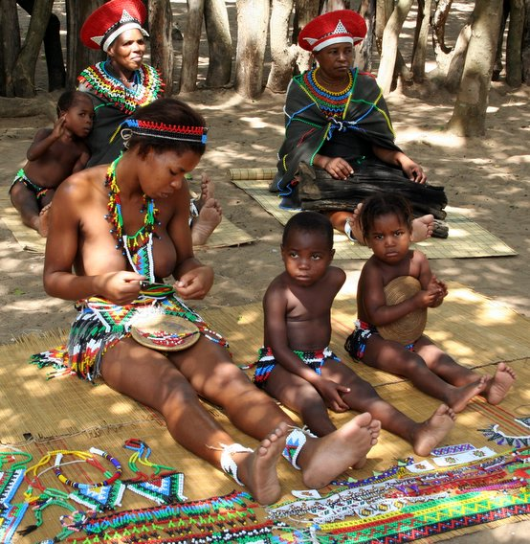
Female traditional Zulu Beadworkers
Made beaded garments for courting, engagements, family consent and weddings and
Beads are worn my men, but also worn by women.
The craft is also an educational tool, teaching young girls how to conduct themselves in their relationships with males.
Notes:
http://chessaleeinlondon.files.wordpress.com/2007/06/zulubeadworkers.jpg

Slide 36
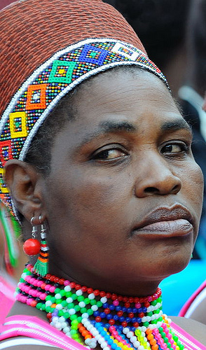
Various geometric patterns
Zulu beadwork is unique, esp. by the codes by which particular colors are selected and combined in various ways to create messages that at the same time are woven into decorative geometrical designs.
Notes:
http://farm4.static.flickr.com/3283/2806058388_d282dd1f76.jpg

Slide 37
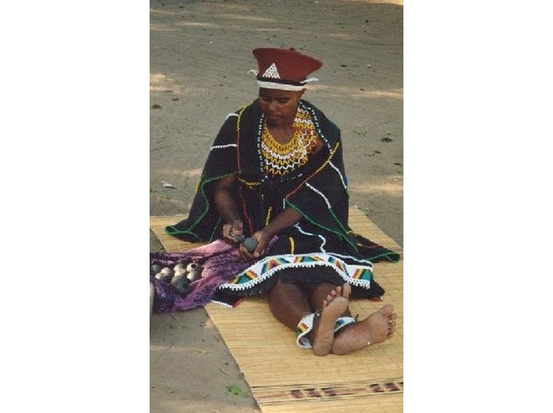
Beads and their “work” or function
females are the designers and manufactures,
males - their traditional clients; but women wear them too.
Beadwork symbolism is encoded within a limited number of colors and geometric figure --- containing coded messages …
Notes:
http://cache.virtualtourist.com/4/839966-MARRIED_ZULU_WOMAN_Hluhluwe.jpg

Slide 38
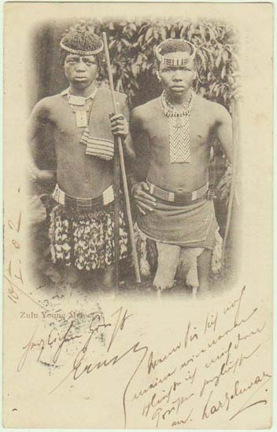
Men and symbolic bead garments
Pre-colonial times
Men wore beadwork to show involvement with women they may have been able to marry.
Beaded garments then would communicate between unrelated males and females, avoiding the discomfort of direct initial discourse on the sensitive subject of personal relations.

Slide 39
these garments have specific social use, but the message is individual depending on the message the maker wanted to convey.
This is an indawana, a young unmarried male's necklace, worn when visiting girls in courtship
This is an example of a lover's gift from a girl to a man, called ibheqe
These t wo objects are called ujiza
signify the acceptance of a young man by a girl
Notes:
Zulu Beadwork collection
http://www.marques.co.za/clients/zulu/necklace.htm

Slide 40
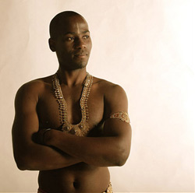
Traditions might continue…but designs can change.
The geometric shapes themselves have particular significance and the craft itself forms an intricate communicational system devoted entirely to the expression of ideas, feelings and facts related to behavior and relations between the sexes.

Slide 41
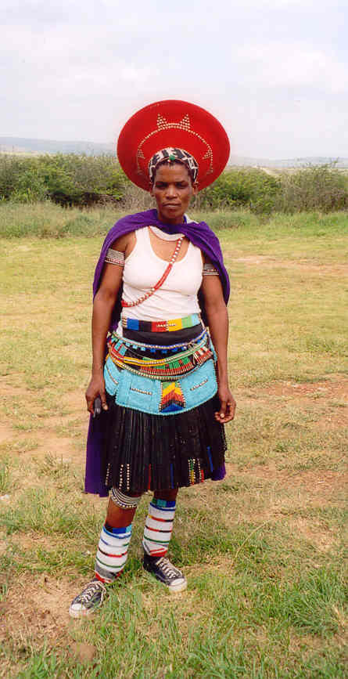
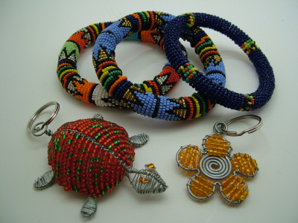
Contemporary Zulu Bead Work in South Africa
Notes:
http://ornamento.files.wordpress.com/2007/08/zulu-beadwork-1.jpg?w=400&h=300

Slide 42
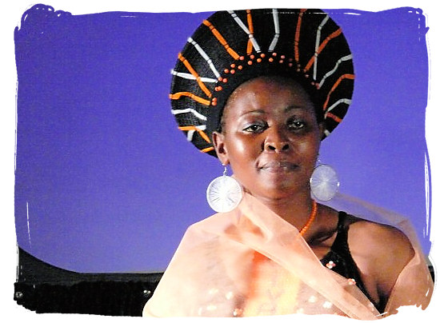
Making fashions out of traditional art
Notes:
http://www.south-africa-tours-and-travel.com/images/zulu-woman-brian-negin-zulupeople.jpg

Slide 43
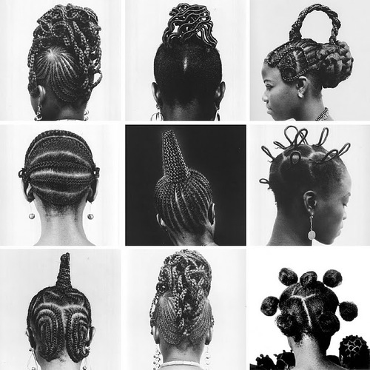
Hair in Nigeria – social status

Slide 44
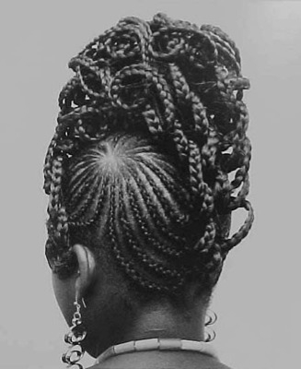
Representations of ethnic identity
There are hundreds of ethnic groups in Nigeria, each with its own traditions.
Among other things which are part of these traditions are various hairstyles.

Slide 45
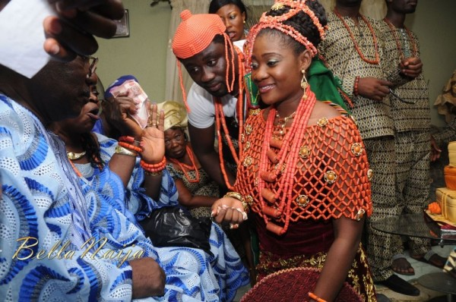
Igbo Wedding
There are special hairstyles for different social occasions,
such as marriage,

Slide 46
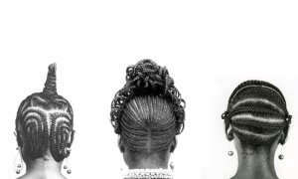
Social status
Hairstyles for either age sets
for social positions in families...

Slide 47
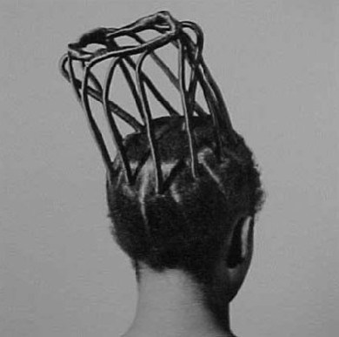
or in society

Slide 48
Photography by Ojeikere
Since 1968 Ojeikere (b. Nigeria, 1930) has been making photographs of various hairstyles he sees on the street or at work, or at celebrations. He always asks his models where the hairstyle they are wearing comes from, what its meaning is, its name, and its history.”
J. D. 'Okhai Ojeikere – Nigerian Hair Styles
6:00 mins
https://www.youtube.com/watch?v=QHEpwppSDHI

Slide 49
The “Hair Style” project
The “Hair Style” project is composed of nearly 1,000 black and white photo images.
http://30.media.tumblr.com/tumblr_l8x50p7AJs1qcerqgo1_500.jpg
See also
Sieber, Roy and Frank Herreman, Hair in African Art and Culture. Munich and New York: The Museum for African Art and Prestel, 2000.
Notes:
http://30.media.tumblr.com/tumblr_l8x50p7AJs1qcerqgo1_500.jpg

Slide 50
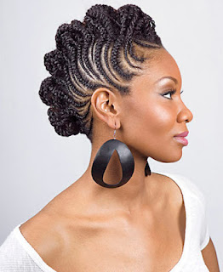
Contemporary creations in Nigerian hairstyles for women…
Example:
The half-braided Mohawk
Notes:
The “Hair Style” project is composed of nearly 1,000 black and white photo images.
http://30.media.tumblr.com/tumblr_l8x50p7AJs1qcerqgo1_500.jpg
half-braided Mohawks
http://3.bp.blogspot.com/-XOEWaqb-2tk/UCpBjGRn5AI/AAAAAAAAAUY/xfi0Np2kNyk/s1600/half-braided-mohawks-i18.jpg

Slide 51
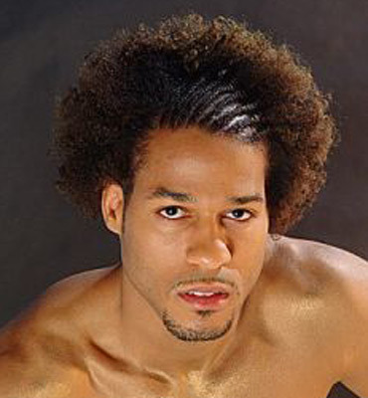
lifestyles and variations on status-
Creative Hairstyles are also for men
Combinations of braiding, shaping, textures etc.
In modern times hairstyles are less about economic or ethnic group markings, and are more about high fashion

Slide 52
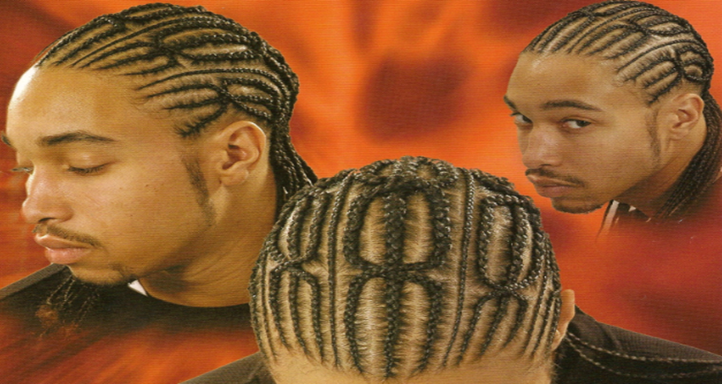
Possible to take traditional patterns and create new ideas

